Slide 1

GTS Shipper Meeting 2023

Slide 2
Programme
Time Presentation Speaker
15:00 Welcome speech Inge Aardse
15:05 Consultation of the planning assumptions to Wendy Docters
determine the required Groningen production
Planning assumptions for gas year 2024/25
15:35 Investment Plan 2024 Manasseh Struijck
Investment portfolio 2024, 2025 and further
Retrospect investments 2021 and 2022
Consultation process
16:00 Short break
16:15 NC TAR decision for the period 2025 – 2029 David Bakker
16.30 Code change to prevent undesirable balancing ACM – Sigourney Zomer
behaviour Sandrie Egberts

Slide 3

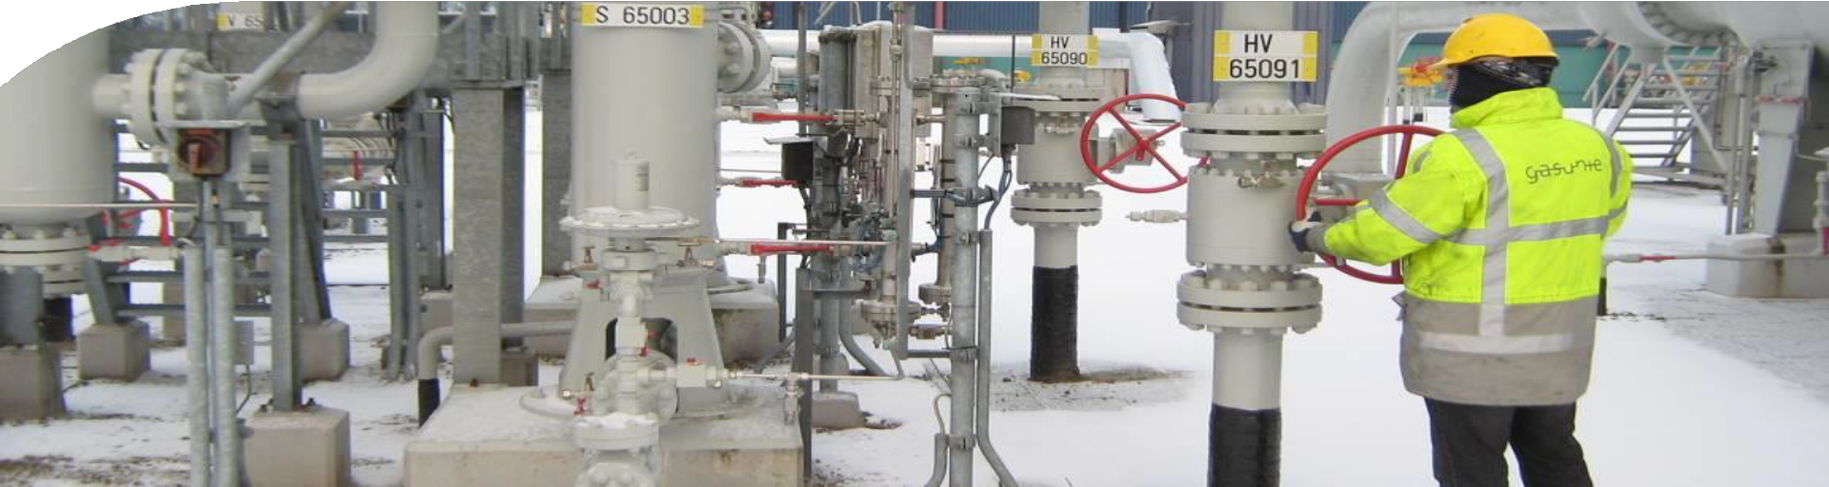
Consultation of the planning assumptions to
determine the required Groningen production
17 October 2023
Planning assumptions for gas year 2024/25
Wendy Docters | Gasunie Transport Services
GTS market session

Slide 4
Three topics
17 October 2023
Consultation of the planning assumptions used for modelling the Groningen production
Legal framework in the near future
Security of supply in the future

Slide 5
Legal framework
17 October 2023
Before the start of the gas year, GTS has the statutory task to advise the State Secretary on the minimal needed capacity and volume from the Groningen field for the security of supply for the coming gas year.
  In this advice, GTS needs to describe the optimal method and means to minimize production from the Groningen field.
  The planning assumptions form the basis for this advice.
  This advice is due before the first of February before the actual gas year starts.
During a gas year, GTS must report any significant deviations from modelled in supply or demand in the gas market, which could affect the required Groningen production.
After the gas year GTS has the statutory task to report to the State Secretary how the realized usage of the G-gas/L-gas means and methods deviate from the model used to calculate the minimal Groningen production for security of supply.

Slide 6
Evaluation gas year 2022/23 - overview
17 October 2023
In January of 2022, we advised the State Secretary of Mining on the necessary production from the Groningen field for the security of supply in 2022/23.
In February of 2022, the situation changed drastically with Russia’s invasion of Ukraine and the extreme decrease of Russian supply
Because of the insecure situation, GTS, TNO and the Mijnraad advised not to close any production locations on the Groningen field in the winter of 2022/23
The State secretary followed this advice in the decree (“Vaststellingsbesluit”) in September 2022.
In January 2023, we advised the State Secretary of Mining on the necessary production from the Groningen field for the security of supply in 2023/24. For security of supply, the availability of all eleven production locations on the Groningen field is needed.

Slide 7
Evaluation gas year 2022/23 - overview
17 October 2023
- Realized number of degree days is 1996.
Small deviation between the modelled and realized G-/L-gas demand on yearly averaged basis.
  Model predicted a G/L-gas demand of 317 TWh while realization showed 290 TWh.
Allowed Groningen production volume has been produced.
No back-up volume was needed.
-
The evaluation shows that GTS performed its legal tasks in such a way, that an optimal contribution was made to minimize the production from the Groningen field with existing means and methods.

Slide 8
Modelling market demand and supply: capacity
17 October 2023
Since gas year 2022/2023 Groningen field is used as a back-up: to safeguard the security of gas supply in line with European regulation¹, capacity is required on the Groningen field.
the regulation states that there must be sufficient capacity to fulfill an exceptionally high gas demand occurring with a statistical probability of once in 20 years in the event of a disruption of the single largest gas infrastructure.
Assumptions
Single largest infrastructure (capacity) = UGS Norg
Once in 20 years is translated to a daily average effective temperature
Method
Determine the market capacity demand, for H- and L- gas at the calculated temperature
Use all facilities at the available capacity (excluding Norg)
Use Groningen to close the gap: that is the required Groningen production capacity for security of supply
Groningen
Peakshaver
Caverns
L-gas market demand
UGS Grijpskerk
UGS Alkmaar
H-gas storages
H-gas conversion and enrichment
G-gas with H-gas
H-gas supply
Domestic production
Import
H-gas market demand
LNG
¹ in line with European Regulation 2017/1938, article 5

Slide 9
Demand assumptions
17 October 2023
Domestic H- and L-gas demand
  Klimaat- en Energieverkenning 2022. Possible correction based on the evaluation of gas year 2022/23.
  Conversion of largest L-gas industries/power plants to H-gas based on the most recent conversion planning.
L-gas demand in Germany, Belgium and France
  Market reduction based upon information supplied by MEAs of Germany, Belgium and France via Task Force L-gas Market Conversion Monitoring. Possible reduction based on the results of evaluation of gas year 2022/23.
H-gas demand from Great Britain (BBL)
At peak temperature, demand is based on the Gas Winter Outlook 2022/23 published by the National Grid.
Limited H-gas demand from the Belgium markets in that can only
be delivered by the Netherlands
Maximum H-gas demand from Germany
Based on recent offtakes and bilaterals with German TSO’s. This holds for the capacity- and the volume modelling

Slide 10
Supply assumptions (1)
17 October 2023
Gas storages Bergermeer, Norg, Grijpskerk and Alkmaar are available.
  We assume gas storages to behave as "normal" seasonal storages: produce during the winter season and inject during summer season, volume-neutral
  We assume that they are available at technical capacity
Caverns are available at technical capacity.
  We assume that there are three Epe’s available and Zuidwending
Peakshaver is available.
Both Gate and EET will be available at technical capacity and available all year.
Limited H-gas supply from Belgium in the winter months depending on the temperatures, and maximum in the summer months.

Slide 11
Supply assumptions (2)
17 October 2023
Limited H-gas supply from Great Britain (BBL) in October and November, depending on the temperatures, and maximum in the summer months.
  Based on recent offtake
A limited constant flow from Norway.
  Based on recent offtake
Domestic production based on the data provided by small field producers.
Limited H-gas supply from German H-gas storages at Oude Statenzijl.

Slide 12
Consultation process
17 October 2023
We would like to ask your opinion/feedback on the planning assumptions. These will be made public unless specified.
Consultation ends on 17 November 2023.
Please send your written view to gasmarket@gastransport.nl
Your written views will be considered in our advice to the State Secretary.
  Letter will be sent before 1 February 2024.

Slide 13
Three topics
17 October 2023
Consultation of the planning assumptions used for modelling the Groningen production
Legal framework in the near future
Security of supply in the future

Slide 14
Legal framework in the future
17 October 2023
The State Secretary has just introduced¹ an amendment of the Gas Act and Mining Act regulating the final termination of gas extraction from the Groningen field.
  The act states that “from October 1, 2024, gas will no longer be extracted from the Groningen field”.
This amendment relieves GTS from its statutory tasks reporting about the necessary Groningen capacity and volumes for the security of supply.
The amendment introduces a new task, which is to advise on the security of supply (which is actually what we already did).
  Demand / supply balances for capacity and volume
  Infrastructure norm and gas delivery norm for protected users from European Regulation 1938/2017 (SoS regulation) should be taken into account

Slide 15
Three topics
17 October 2023
Consultation of the planning assumptions used for modelling the Groningen production
Legal framework in the near future
Security of supply in the future

Slide 16
Security of supply in the future
17 October 2023
In the Netherlands, security of supply is defined as “end users are supplied with gas at the right time, at the right quantity (low or high caloric) and in the required quantity, even when demand is high”.
End users are protected Dutch users, non-protected Dutch users and international users via our border points.
Security of supply should be seen in an international context
  Recitals and provisions of Regulation 715/2009, Directive 2009/73 and SoS regulation
  An example is the L-gas market in Belgium, France and Germany
Due to the closing of the Groningen field, the decreasing production from the small fields, the loss of Russian gas and insecurities concerning other import security of supply is no longer a given in the Netherlands.
  The Ministery of Economic Affairs is planning on drafting a new act on security of supply, which is expected in 2025.
  GTS contributes in the discussion wich elements should be in the Dutch SoS law

Slide 17

Investment Plan 2024
Investment portfolio 2024, 2025 and further / Retrospect investments 2021 and 2022 / Consultation process
Manasseh Struijck | Gasunie Transport Services

Slide 18
The Investment Plan
GTS publishes an Investment Plan (IP) every two years. With this IP GTS provides an overview of all proposed investments.
The main components of the IP are:
  developments and trends in the energy market;
  an analysis to identify capacity and quality bottlenecks;
  a description of the investment portfolio for the coming years.
During a previous market session in November 2022, GTS explained the objective, the role of the stakeholders and the scenario development of IP2024.
During this market session GTS will focus on the investment portfolio, retrospect 2021/2022 and the upcoming public consultation.

Slide 19
From scenarios to bottlenecks to investments
Capacity bottlenecks
Scenarios are set up until 2035
Gas transport capacity analysis
Determining capacity bottlenecks
Determining capacity investments
Quality bottlenecks
Improve condition or quality of the system
Reducing asset risks (Risk Based Asset Management)
Determining quality investments
External factors
Connections and relocations

Slide 20
Investment portfolio
Investment portfolio consists of the following categories:
Regular investments: investments in the gas transport network < € 5M
Major investments: investments in the gas transport network ≥ € 5M
Connections and relocation investments

Slide 22
Overview to look back at planned vs. realized investments.
Scope: the realized investments in 2021 and 2022 as planned in previous IP’s.

Slide 23
Milestones IP2024
Today
Market session
28 November 2023
End of consultation IP2024
April 2024
Publication of IP2024
Assessment of IP2024 by ACM & Ministry of Economic Affairs and Climate Policy (MEA)
1 November 2023
Start consultation IP2024
2 January 2024
Submittal of IP2024 to ACM & MEA
Consultation responses to:gasmarket@gastransport.nl

Slide 24
Short break

Slide 25
NC TAR agreement 2025 - 2029
David Bakker | Gasunie Transport Services

Slide 26
Main elements NC TAR agreement 2025 - 2029
NC TAR agreement has been signed yesterday by (amongst others) representative organizations, ACM and GTS. The aim of the agreement is to (re-)start with a clean sheet and to underline the modus of constructive cooperation between parties instead of a focus on legal procedures.
Representative organizations withdraw current legal procedures and new legal procedures on these topics are excluded;
Appeals on the NC TAR decision and / or NC TAR parameters (entry/exit-split, discount for gas storage operators and LNG terminals, etc.) are excluded for the period 2025-2029;
Appeals relating to CPI-related issues regarding this regulatory period (2022-2026) are excluded for both GTS and representative organizations;
GTS agrees – on a voluntary basis – with a retroactive adjustment of the CPI percentages as applied in Tariff Decisions 2022 and 2023 resulting in a one-off reduction of the allowed revenues of GTS in 2025 of EUR 107 million;
In the event one or more representative organizations do not comply with the obligations as set out in the agreement (e.g. by launching an appeal on an excluded matter) the ACM will undo the one-off reduction of the 2025 allowed revenues of GTS. rebate of the rebate of EUR 107 million).
Some NC TAR elements will be changed (next sheet)

Slide 27
NC TAR elements: Mainly the same with some changes
Key elements | NC TAR 2020 -2024 | NC TAR 2025 – 2029 Empty box means not changed
Services | All five legal GTS tasks labelled as transmission service
Reference Price Methodology | Postage stamp
Share allowed revenue entry | 40% ex ante
Share allowed revenue exit | 60% ex ante
Storage discount | 60% | 75%: in case of closed loop 0%: in case of cross-border flow VGN/SSO/GTS to develop solution
LNG discount | 0% | 2025, 2026: 20% 2027/2028/2029: conditional 20% In case average gas price > 37,5 EUR/MWh and LNG share > 25%
Multiplier D and WD product | 1,75
Multiplier for M product | 1,50
Multiplier for Q product | 1,25
Seasonal factors | Yes | Yes, but flatter pattern
Interruptible capacity discount | Ex ante; 1 discount for all points | Ex ante; different discounts possible reflecting the chance of interruption on a network point

Slide 28
Undesirable balancing behaviour
Explanation by the ACM and GTS
Sigourney Zomer | ACM & Sandrie Egberts | Gasunie Transport Services

Slide 29


Transmission code change: prevention of undesirable balancing behaviour
Sigourney Zomer
sigourney.zomer@acm.nl

Slide 30
Transmission code change to prevent undesirable balancing behaviour
To ensure safe transport of gas, the gas transmission network must be in balance.
Concrete implementation of the balancing responsibility from European Network Code on Gas Balancing (312/2014)
Art. 4 par. 1 NC BAL: The network users shall be responsible to balance their balancing portfolios in order to minimise the need for transmission system operators to undertake balancing actions […].
Financial charge in case of undesirable balancing behaviour and possibly license revocation in case of repeated undesirable behaviour.
The code change comes into effect on January 1st, 2024.

Slide 31
Criteria for undesirable balancing behaviour
A balancing action has taken place
and
The network user was one of the causers of this balancing action
and
The portfolio imbalance of the network user is larger than 15% of the absolute limit value of the dark green zone
and
At least one of the following circumstances apply:
TTF allocations are a main part of the portfolio: Value of TTF allocations is larger than the sum of all physical entry and exit allocations; or The portfolio has no allocation at physical entry or exit points | or | The portfolio imbalance is larger than the total portfolio size.

Slide 32
Other remarks
Exemption for unexpected physical disruptions
The imbalance at the specific entry or exit point will not be considered when determining whether the network user shows undesirable balancing behaviour.
Adversarial process
In case all criteria for undesirable balancing behaviour are met, GTS will give the network user the opportunity to argue for an exemption.
Yearly evaluation
GTS together with representative organizations
The evaluation may lead to changes in the code

Slide 33
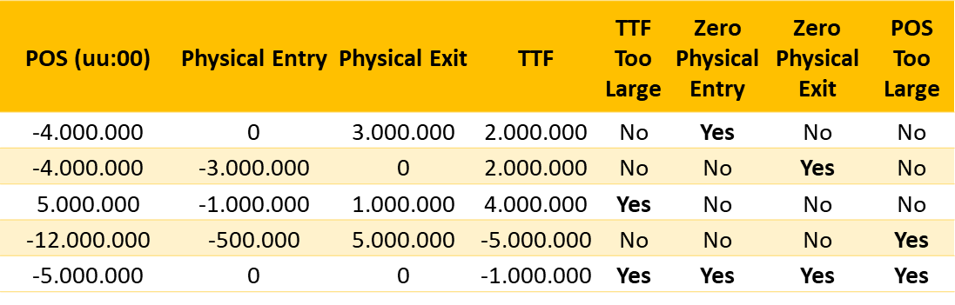
Examples undesirable balancing behaviour numbers in kWh
Physical Entry includes: Entry GTS, Entry BBL and Entry Green gas (RNB)
Physical Exit includes: Exit GTS and Exit BBL
TTF includes: TTF Balance and TTFB
The provided information will also show Transaction ID/time, previous POS, SBS, predicted SBS and applicable zone size

Slide 34
Billing undesirable balancing behaviour
GTS will inform shippers by email in November/December if they have shown undesirable behaviour during balancing actions in 2023. This overview is provided to give shippers insight into their own balancing behaviour.
Should shippers exhibit unwanted balancing behaviour from January 1, 2024, GTS will notify the contractual contact person on the first occurrence without consequences .
If the shipper subsequently exhibits undesirable balancing behaviour again, GTS will inform the shipper, and the shipper will then have 2 weeks to react and explain in further detail its view on the matter. This explanation might also include physical interference.
Normal invoicing of balancing actions is at the first working day of the month. Invoicing of these charges will take place the next month.

Slide 35

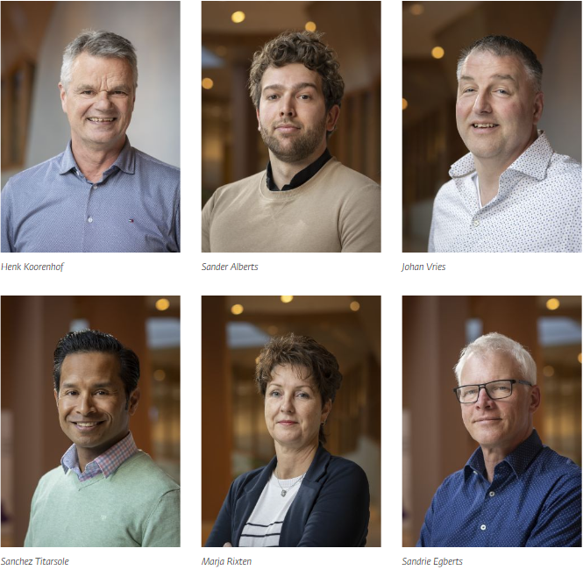
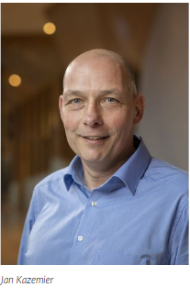

Do you still have questions or remarks?
Please contact our Customerdesk
Alie Nieuwold

Slide 36

Thank you for your attention

